Slide 1
Equity Allies
March 23rd 2021

Slide 2
What is Educational Equity?
When educational policies, practices, interactions, and resources are representative of, constructed by, and responsive to all people so that each individual has access to, meaningfully participates in, and has positive outcomes from high-quality learning experiences, regardless of individual characteristics and group memberships (Midwest Equity and Plains, 2012).
Access
All students (and other stakeholders) have entrance into, involvement with, and full benefit of quality learning opportunities (Paris, 2012).
Representation
Being present in decision-making and content (Mulligan & Kozleski, 2009; Chen et al, 2014).
Meaningful Participation
All students (and other stakeholders) have agency and are empowered to contribute in effective ways.
High Outcomes
Solutions benefit all students towards self-determination and the ability to act as contributing citizens in a democratic society and global community.

Slide 3
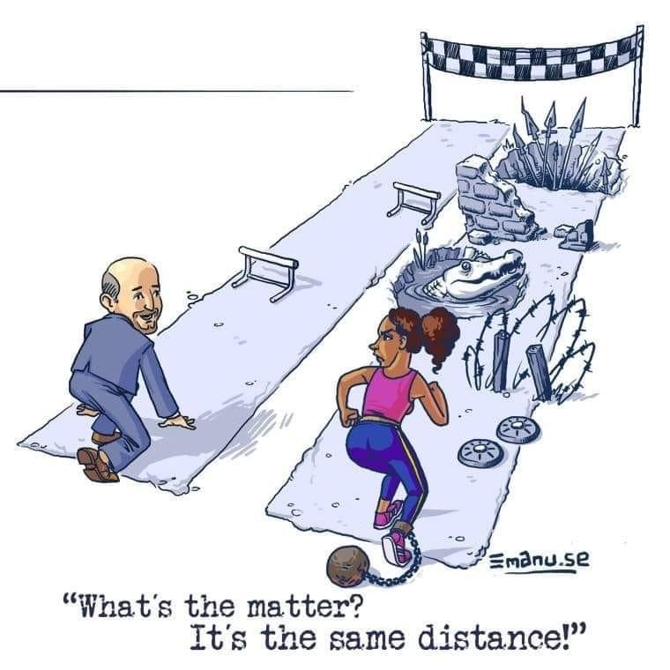
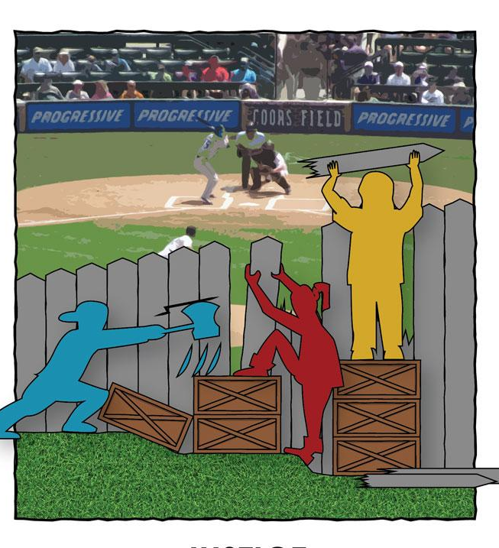
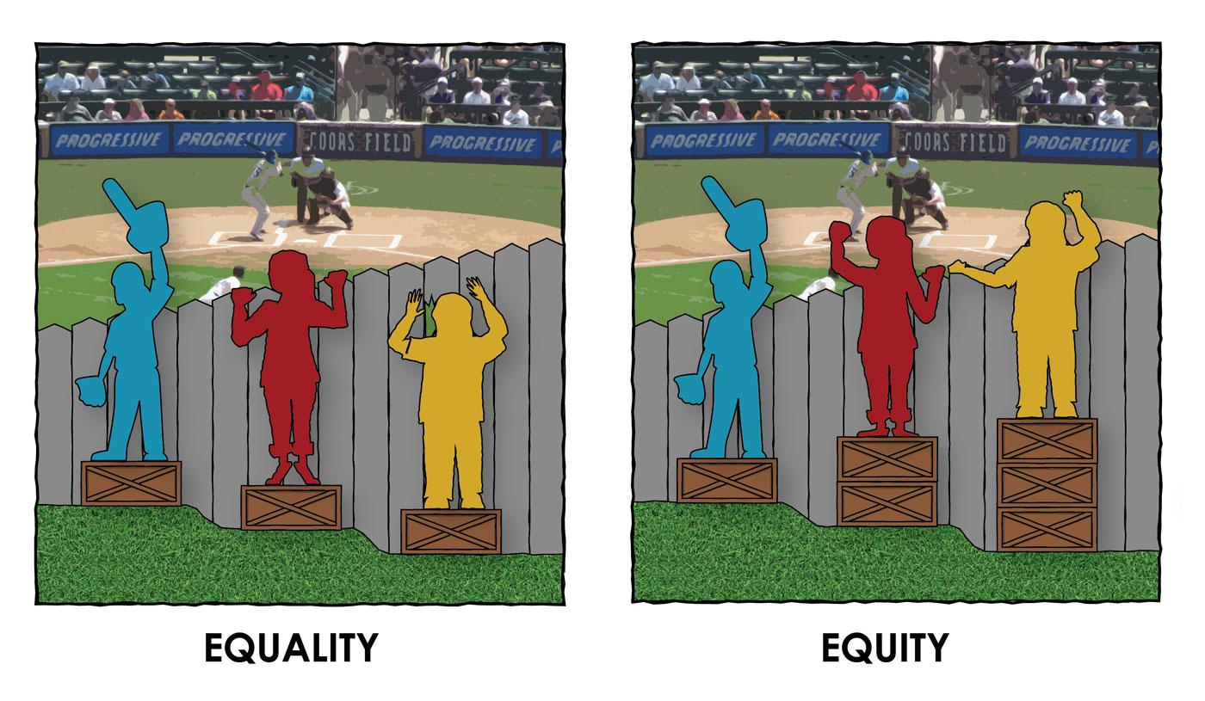
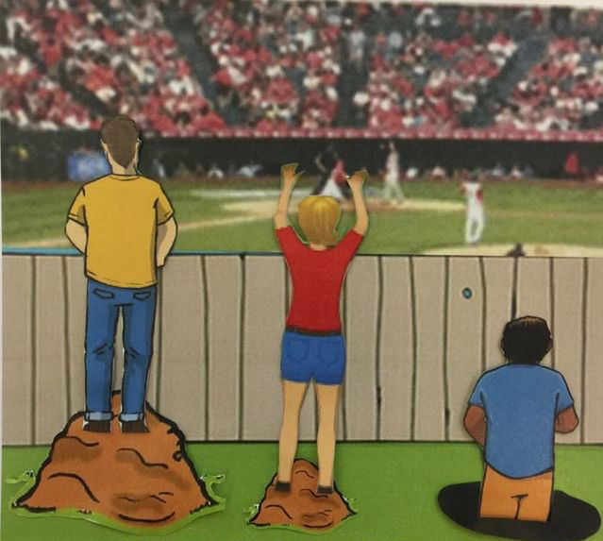
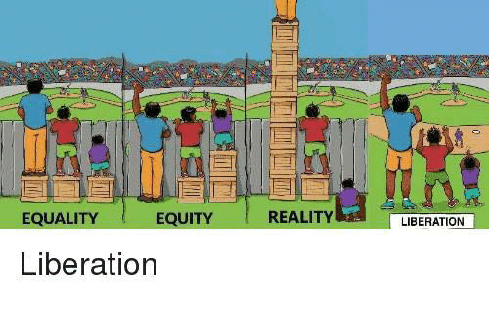
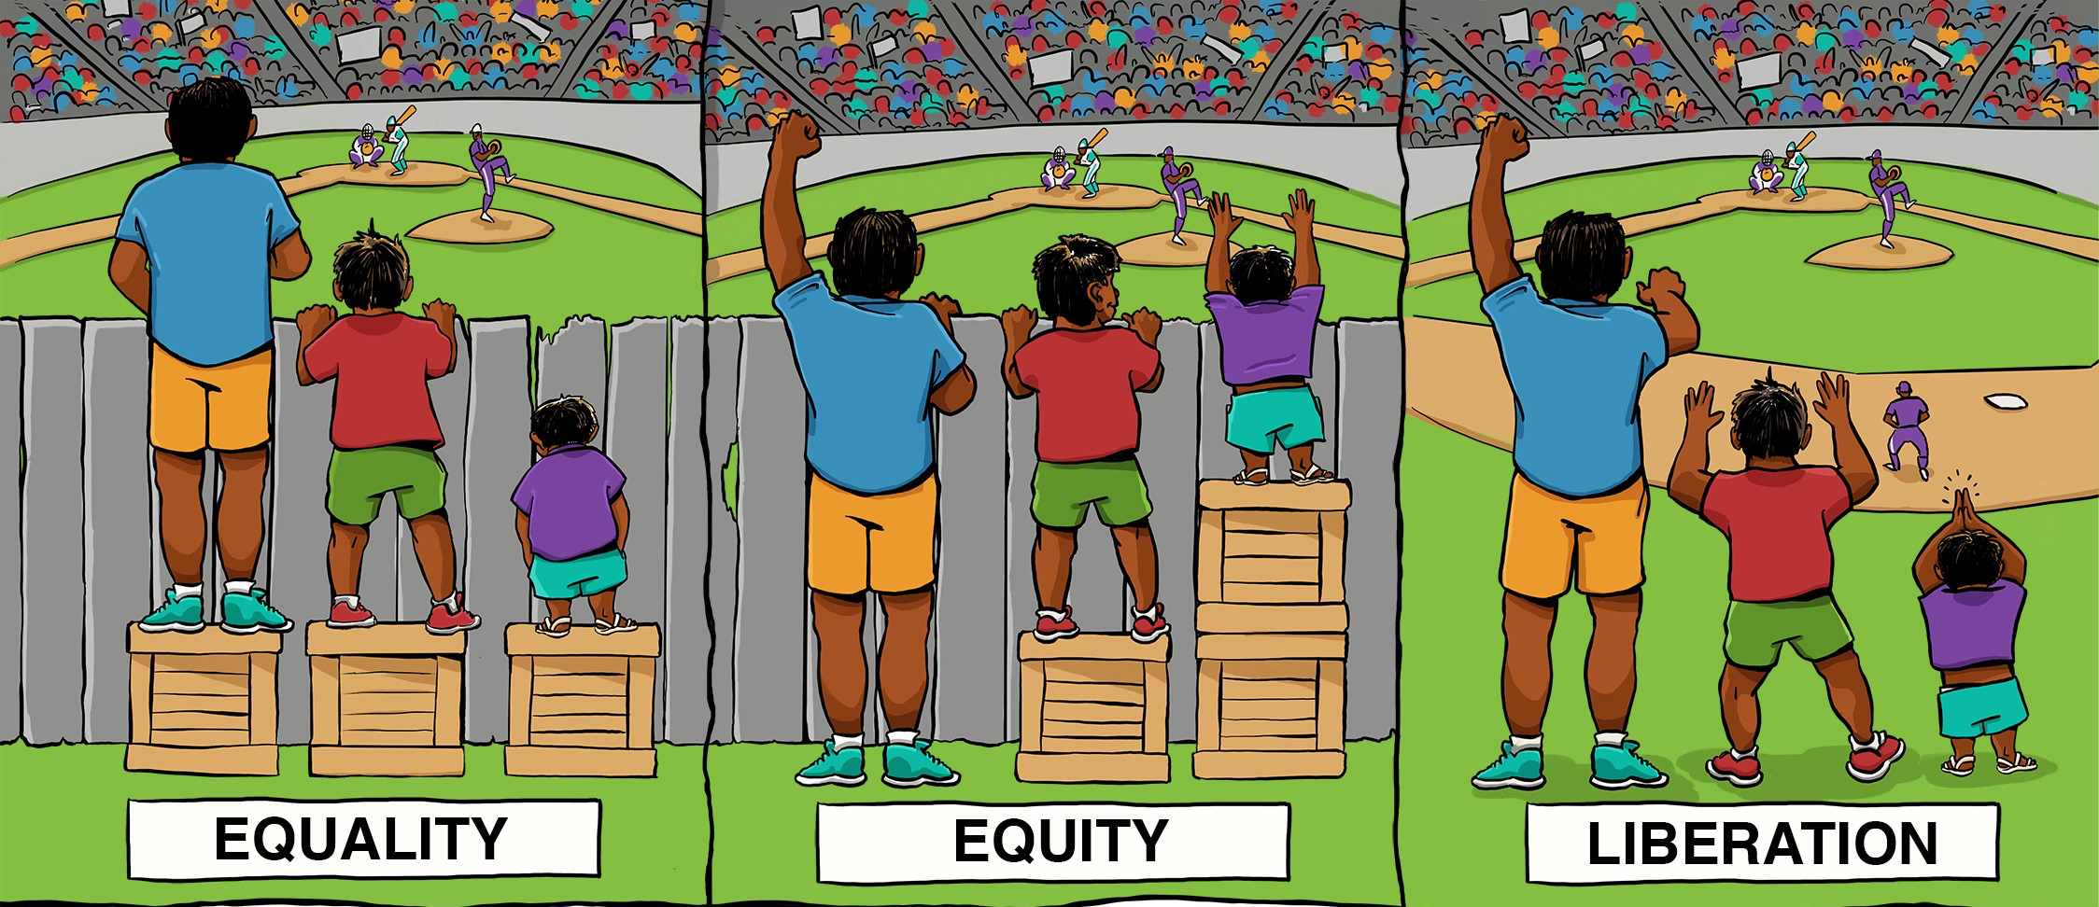
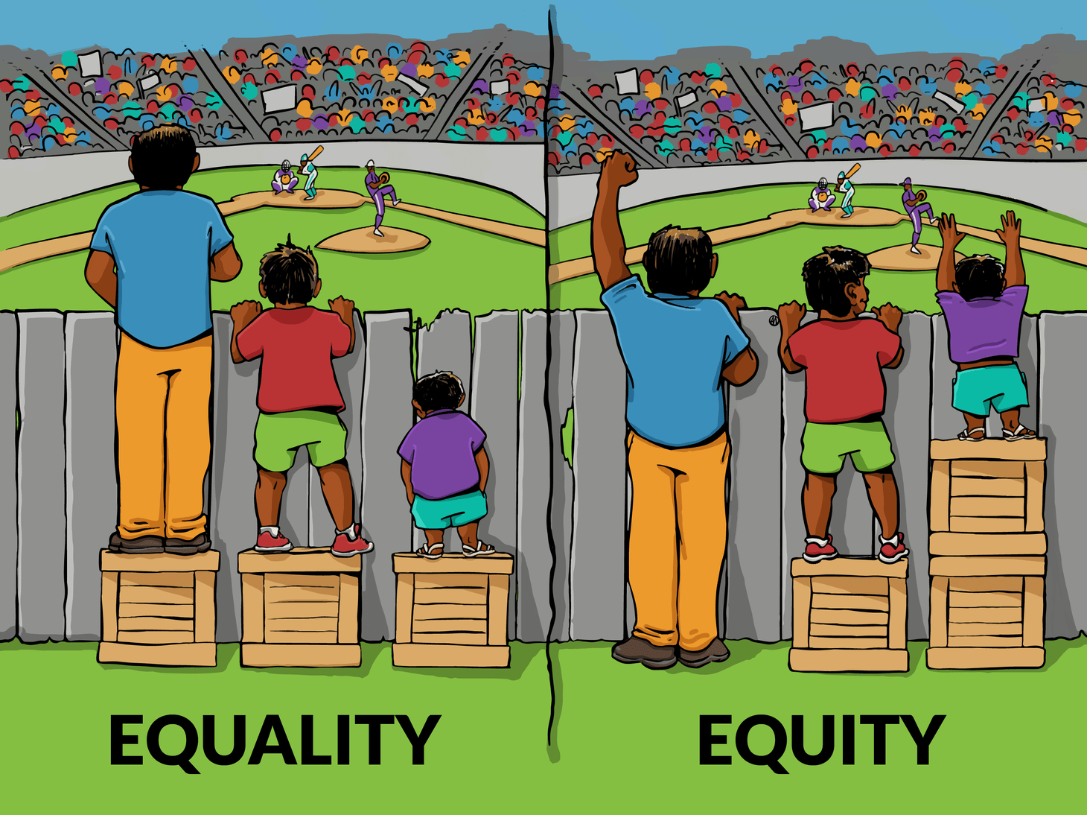
Awareness:
What IS the gap? And, why does it exist?
How do we get here?
Access
Representation
Meaningful Participation
High Outcomes
Inequality
Equality
Equity
Justice
Justice

Slide 4
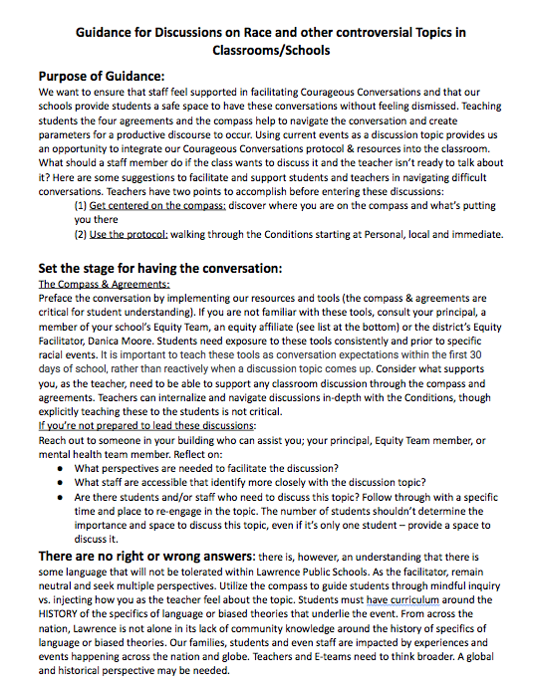
Effective Conversations
Guidance for discussions on race and other controversial topics in classrooms and schools
Highlights:
Use of compass to prepare for conversations
Teaching students protocols to have effective conversations
Supports and tools for teachers
Suggestions and prompts to facilitate deeper discussion
Professional Learning
Conversations about Race
Most critical elements included: CCAR tools (compass)
Notes:
Leah

Slide 5
Building Equity Teams (E-teams)
“Conversations about Race”
Collaborative planning: C&I, Affiliates/Practitioners
Begin with and build from our fall staff
professional learning
Strengthen E-Team capacity in their:
Use of protocol and modeling effective conversations
Collecting data and providing professional learning
Proactive support for all staff through professional learning
Notes:
Leah

Slide 6
Teaching Courageous Conversations

Slide 8
Questions?
Thank you!

